Slide 1

An Analysis of Wafer Defect Patterns to Assess Yield,
Prevalence, and Automate Wafer Defect Classification
Business Presentation
Kaustubh Indane

Slide 2
Motivation
Target Audience:
Business Managers & Engineers
Problem Statement:
Manual defect inspection costs engineering time and delays process improvements. Semiconductor manufacturing depends on defect reduction to optimize yield. Goal is to develop an automated classification system to save $500k - $2M in classification costs annually.
Research Questions:
Can we quantify and prioritize resolutions of defect classes based on yield and prevalence?
Can we provide insights to assist engineers with root cause sourcing of defects?
Can we develop strong, efficient model with high accuracy and low computation time for implementation?
Kaustubh Indane

Slide 3
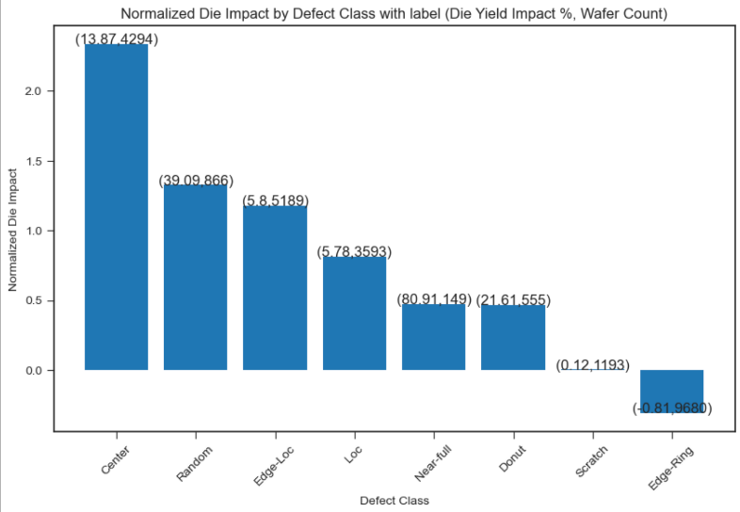
EDA Insights – For Engineers
Baseline yield loss = 8.17%
Defect Resolution Prioritization:
Slot dependency: Edge wafers in lots show higher defect rates → recommend more lot buffering with dummy wafers
Edge-Ring defects spiked in Lots 26400–32400 → engineers should investigate tool/process changes.
Center Defects: Highest total yield loss (~13.9% per wafer).
Random Defects: High yield loss, further classification needed
Scratch, Edge-Ring, Near-full, Donut: Lowest impact, low priority
Kaustubh Indane

Slide 4
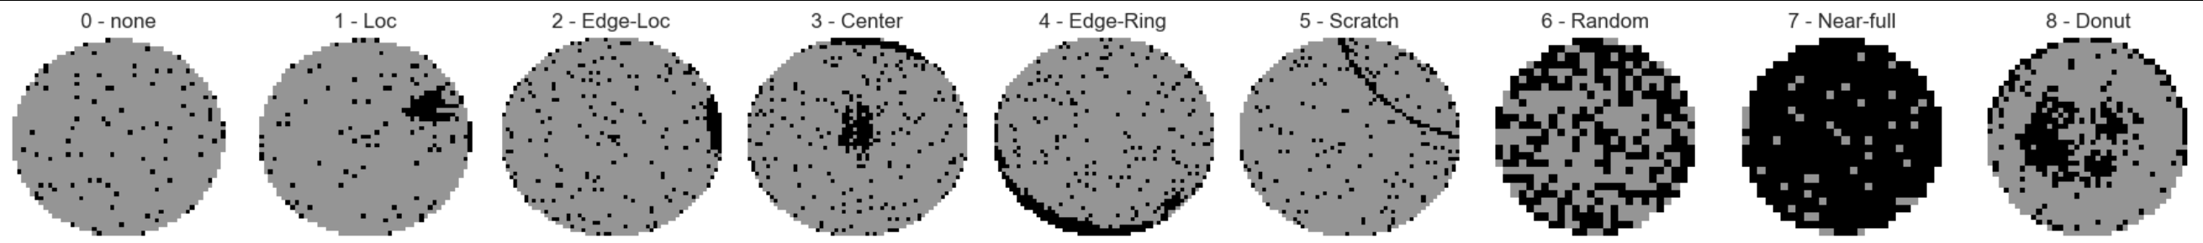
Modeling Methodology
MIR-WM118K Dataset - 9 defect class buckets
k-NN Model: Baseline Model
Random Forest Model: Baseline Model
Custom CNN: High Accuracy Model
MobileNetv2: Industry Benchmark Model
Kaustubh Indane

Slide 5
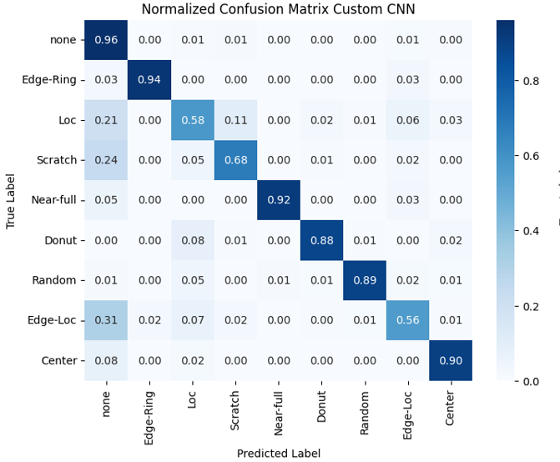
Business Recommendation
Custom CNN model had best accuracy (94%) and fastest computation time (2.6 seconds). Ideal model for implementation.
Further Studies/Improvements
Misclassifies ~25% of Loc, Scratch, and Edge-Loc defects as ‘none’
Ensemble voting methods for better recall + accuracy
Transformer-based vision models
MobileNetv2 implementation, which is optimized for multi-channel (RGB) with high benchmarks for performance on wafer defect classification. Helps classify defect morphologies at an individual level instead of broad defect patterns
Kaustubh Indane

